Slide 1

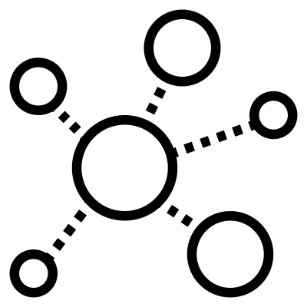
FUTURE TOKEN LAUNCHES
ECR holders receive token asset distributions in new dApps (decentralized applications) that launch on the Epicenter Ecosystem.
EMPL
EON
EDX
ECHO
ECR TOKEN HOLDERS
Issued to ECR token holders via ECR wallet snapshot and airgrab
empl
EMPL Rebase Token: Epicenter Marketplace Price Level Tracker
Used as a noncorrelated volatility reduction component to balance portfolios.
Rebase token "Epicenter Marketplace Price Level Tracker" used as a noncorrelated volatility reduction component to balance portfolios.
Token: exclusive home Polkadot
Similar to: AMPL
eon
EON Liquidity Network
Native currency of EON, a smart contract platform that handles cross-chain and administrative duties for the ecosystem.
EON is a proof of stake protocol using Tendermint consensus.
Similar to: ATOM
edx
EDEX Decentralized Non-Custodial P2P Exchange
Utility token for EDEX Decentralized Exchange Protocol, used to pay fees.
Token: Ethereum
Similar to: SRM, VITE
Echo
Immutable censorship resistant content distribution network
Echo combines blockchain + tor + torrent technologies to enable censorship resistant, immutable, tamper evident content distribution at scale - torrent protocols are among the only to get faster as usage grows, the inverse of the usual scenario.
Echo assures content creators that their work can never be deplatformed or demonetized. Users store torrent seeds in exchange for tokens, and a directory of these + associated metadata is stored on chain in the EON distributed ledger.
Token: EON
Similar to: FIL, STEEM, HIVE, 1UP
Epicenter Token Launches 020221 v01

